Slide 1

S3 Event Notifications Using an SNS Topic
Cloud
Computing
- Yashaswi Tirole (27458)

Slide 2
Contents
01
02
03
04
Introduction
Services
Practical
Challenges Faced
Objective and scope of project
List and scope of services integrated
Screenshot of practical performed
All challenges faced during implementation of project

Slide 3
01
Introduction
2022

Slide 4

Objective
To gain hands-on experience with AWS event-driven architecture by configuring Amazon S3 to send real-time notifications using Amazon SNS when specific events, such as object creation, occur in the bucket.
Workshop

Slide 5
Scope
2022
S3 Event Alert Capability
Event-Driven Automation
Demonstrates the use of Amazon S3 event notification capabilities.
Explores how automated workflows can be triggered by cloud events without manual intervention.
SNS Integration
Cloud Architecture Foundation
Showcases how to use Amazon SNS to distribute S3 notifications to multiple subscribers.
Builds core skills needed for scalable, decoupled architecture design using AWS services.
IAM Policy Implementation
DevOps & Monitoring Use Case
Applies custom IAM policies to securely allow S3 to publish to SNS.
Develops reusable patterns applicable to logging, monitoring, and DevOps automation.

Slide 6
02
Services
2022

Slide 7
List of Services
01
02
03
Amazon S3
Amazon SNS
IAM
Introduction: Simple Storage Service is a scalable cloud object storage supporting event-based triggers.
Introduction: Simple Notification Service Managed messaging service for broadcasting notifications to multiple endpoints.
Introduction: Identity Access Management manages secure access control for AWS services and resources.
Why Used: Acts as the source of events. It monitors file uploads and triggers notifications accordingly.
Why Used: Receives events from S3 and forwards notifications to subscribed endpoints (email, Lambda, etc.).
Why Used: Provides the necessary permissions for S3 to publish events to the SNS topic securely.
How It Connects to This Project: It triggers an event when a file is uploaded, acting as the starting point of the notification workflow.
How It Connects to This Project: It receives the event from S3 and sends it as an email notification.
How It Connects to This Project: Ensures only the specified S3 bucket can publish messages to the SNS topic.

Slide 8
Scope and Usecase of services
Integrated
Scope:
Acts as a centralized event source that reacts to object-level activities (e.g., uploads).
Scope: Distributes event messages from S3 to multiple endpoints such as email, Lambda, or mobile notifications.
Scope: Defines and enforces permission rules that enable secure interaction between S3 and SNS.
Amazon S3
Amazon SNS
Amazon IAM
Use Case: When a file is added to the S3 bucket, it triggers a configured event, initiating the notification pipeline.
Use Case: Sends real-time notifications to all subscribers upon receiving the file upload event from S3.
Use Case: Grants the correct level of access to S3 so it can push notifications to the designated SNS topic.
2022

Slide 9
03
Practical
2022

Slide 10
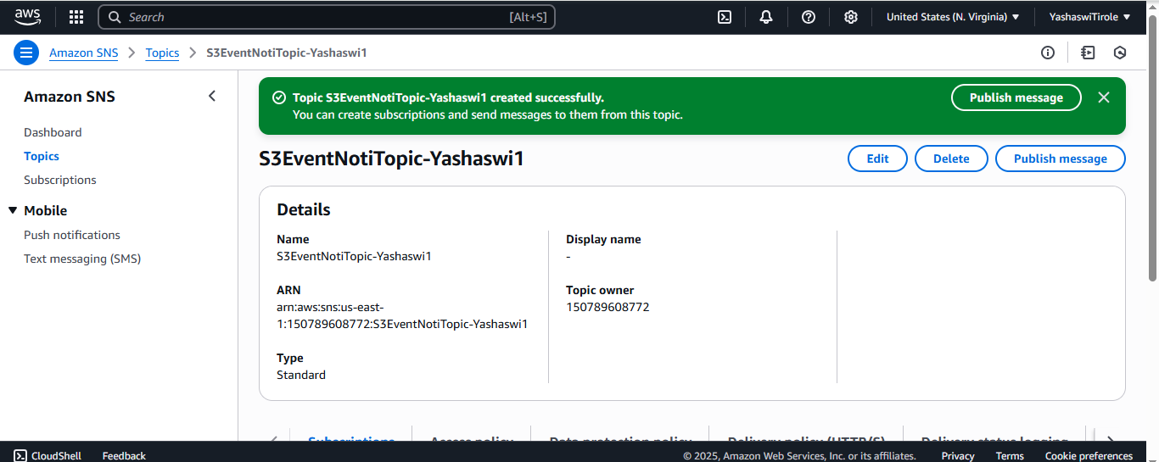
STEP 1: Create an SNS topic
→ Go to SNS in the AWS Console → Create a new topic with type "Standard"
→ Name the topic (e.g., S3EventTopic) →Copy the ARN of the topic

Slide 11
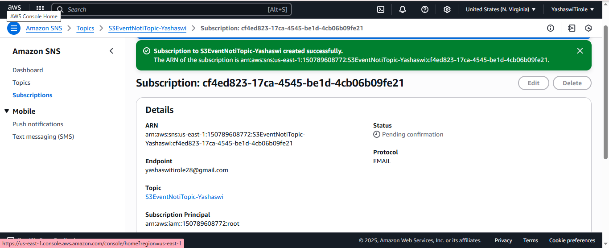
STEP 2: Subscribe to the SNS Topic
→ Create a new subscription (e.g., Email) → Provide a valid email address
→ Confirm the subscription via email

Slide 12
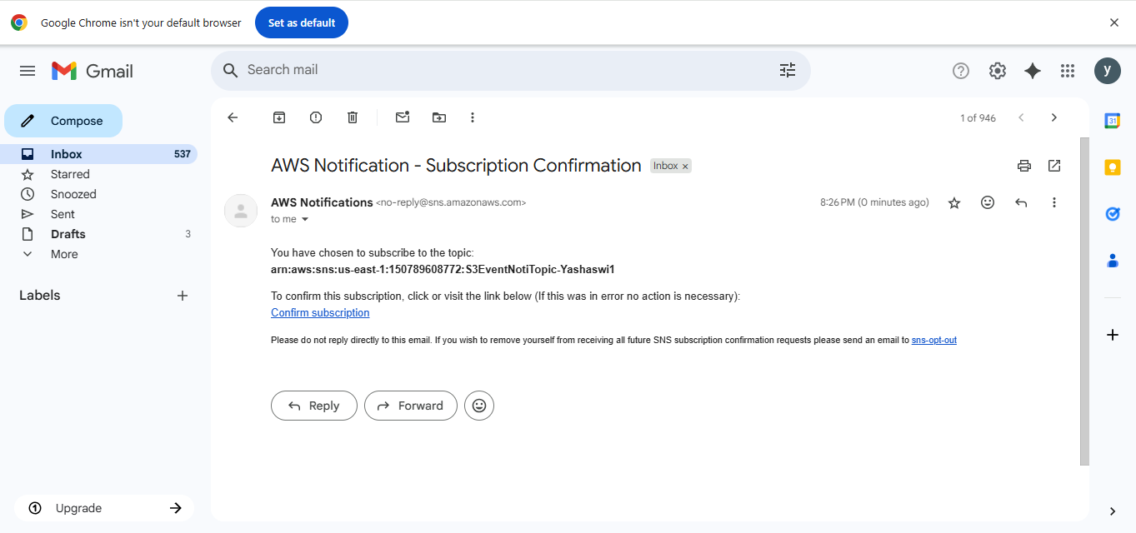
STEP 3: Mail Confirmation
→ Open the mail inbox provided above → Open the confirmation mail sent
→ Click on confirm mail

Slide 13
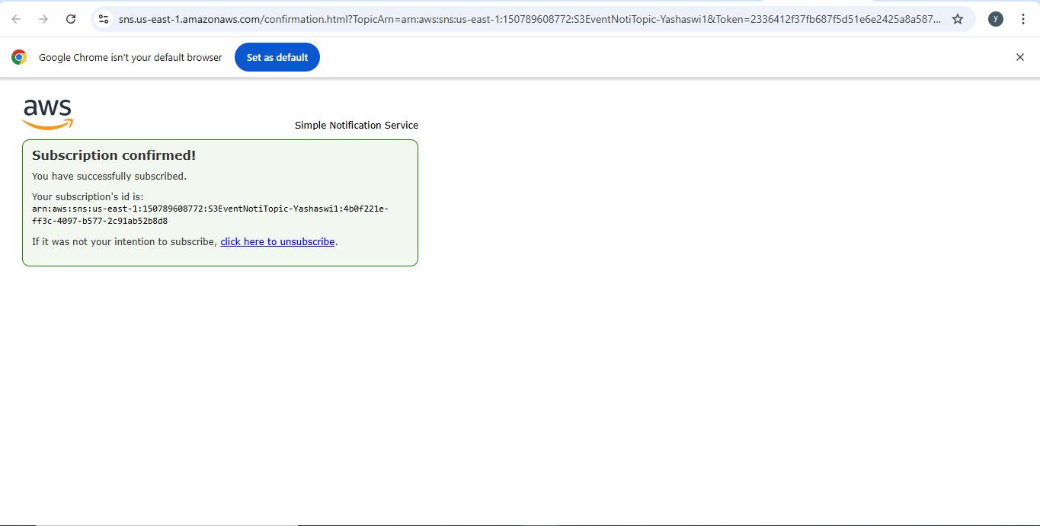

Slide 14
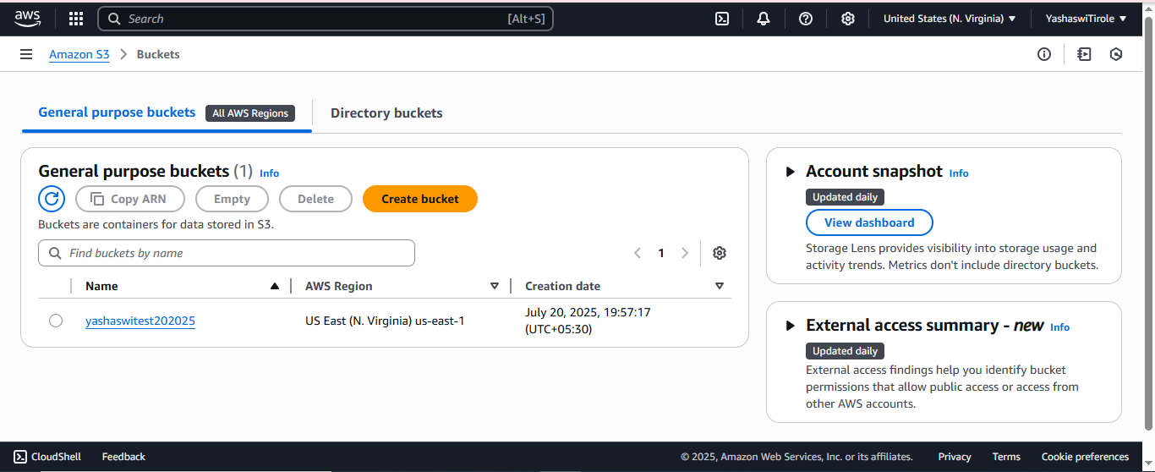
STEP 5: Create or Choose an S3 Bucket
→ Navigate to S3 in the AWS Console → Either create a new bucket or use an existing one

Slide 15
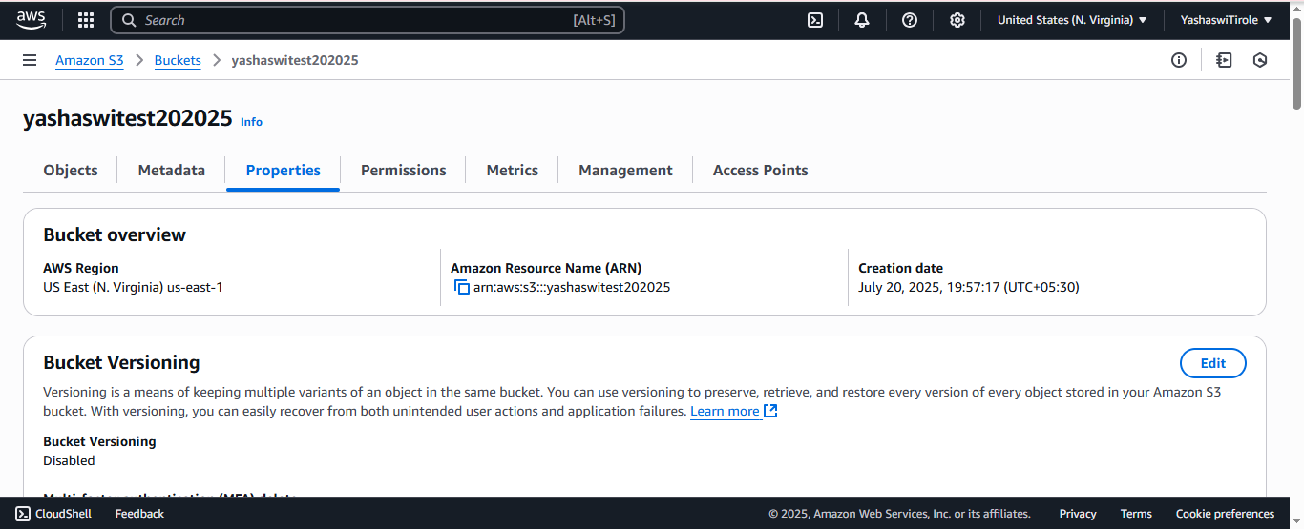
→ Copy and save ARN number of bucket → Copy and save your AWS Account ID

Slide 16
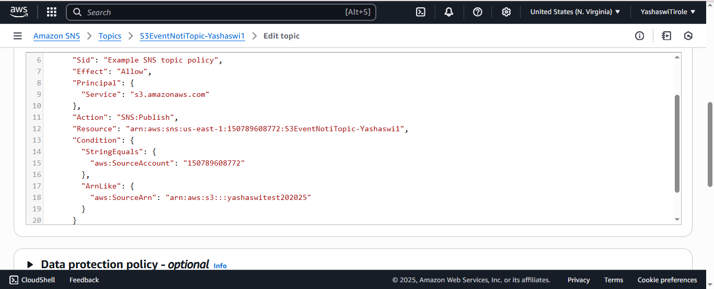
STEP 5: Editing SNS Access Policy
→ Navigate to Amazon SNS → Select your topic and click on edit to change access (Replace Topic ARN, Source ARN, Account_ID)policy → Save changes

Slide 17
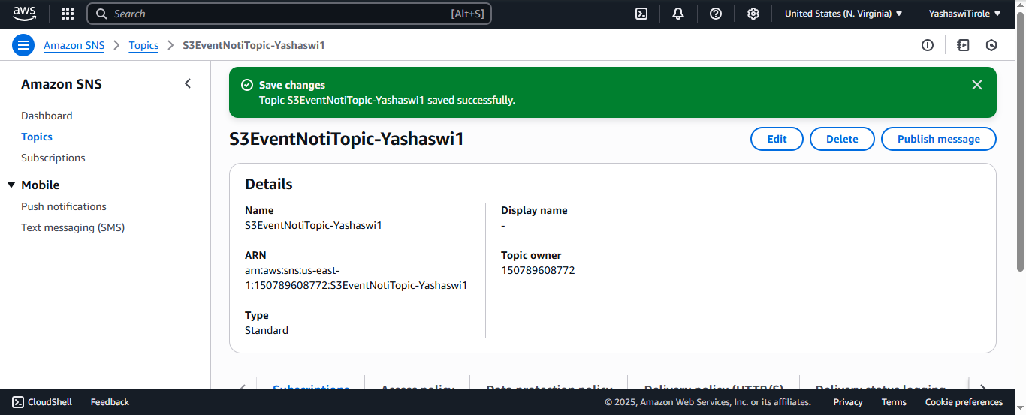

Slide 18
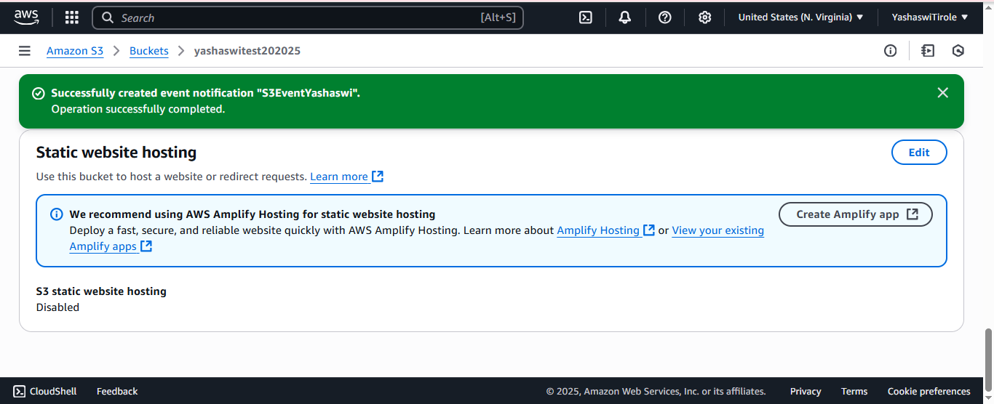
STEP 6: Configure Event Notifications
→ Create a new event notification → Name the event (e.g., NewObjectEvent) → Event type: PUT → Destination: SNS Topic → Choose the previously created SNS topic

Slide 19
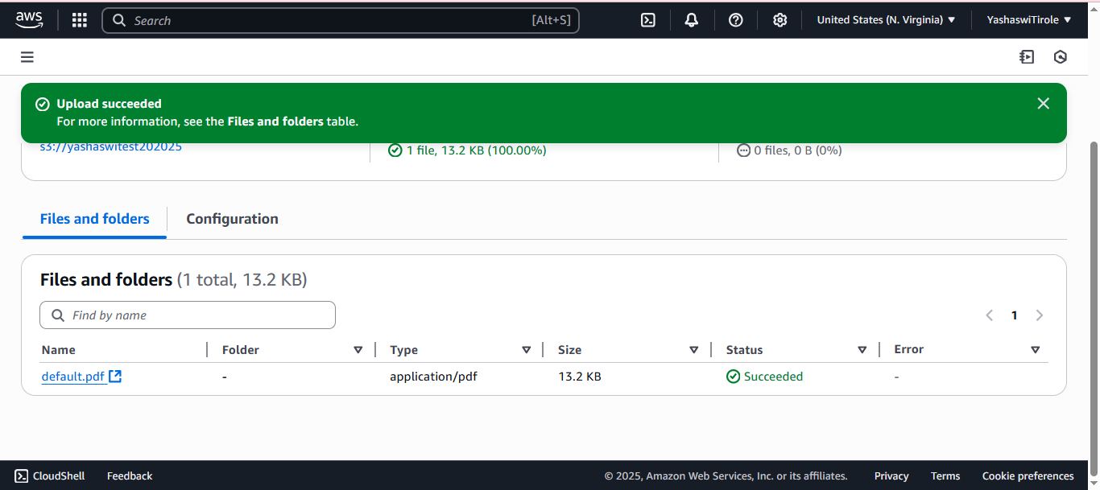
STEP 7: Uploading Files to S3 bucket
→ Open the S3 bucket created by you that has been linked → Upload a file successfully

Slide 20
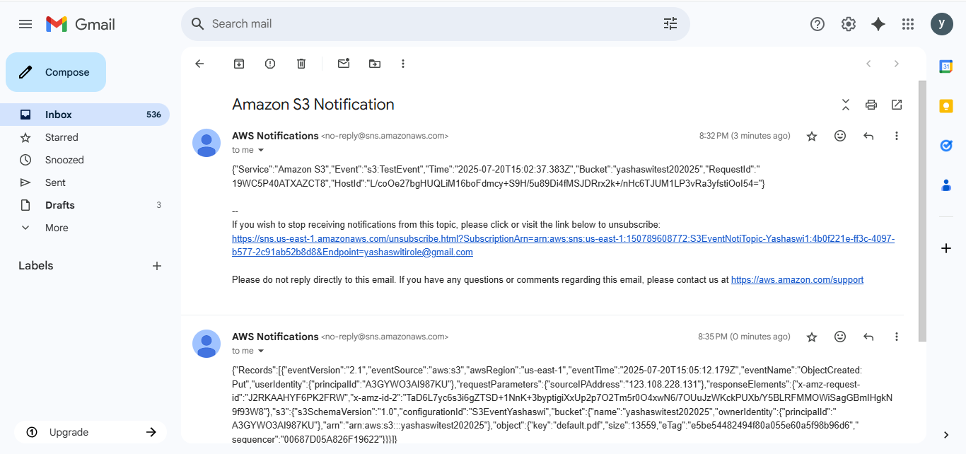
STEP 8: Receiving Mail About File Upload
→ Open the mail which has been linked with SNS and check the inbox for the notification triggered after the file upload in S3 bucket

Slide 21
04
Challenges Faced
2022

Slide 22
Challenges Faced
01
Misconfigured IAM policy prevented initial event triggering.
02
Delay in SNS email subscription confirmation.

Slide 23



Thanks!
yashaswitirole@gmail.com
https://in.linkedin.com/in/yashaswi-tirole
https://yashaswitir28.github.io/
https://github.com/Yashaswitir28

